Slide 1
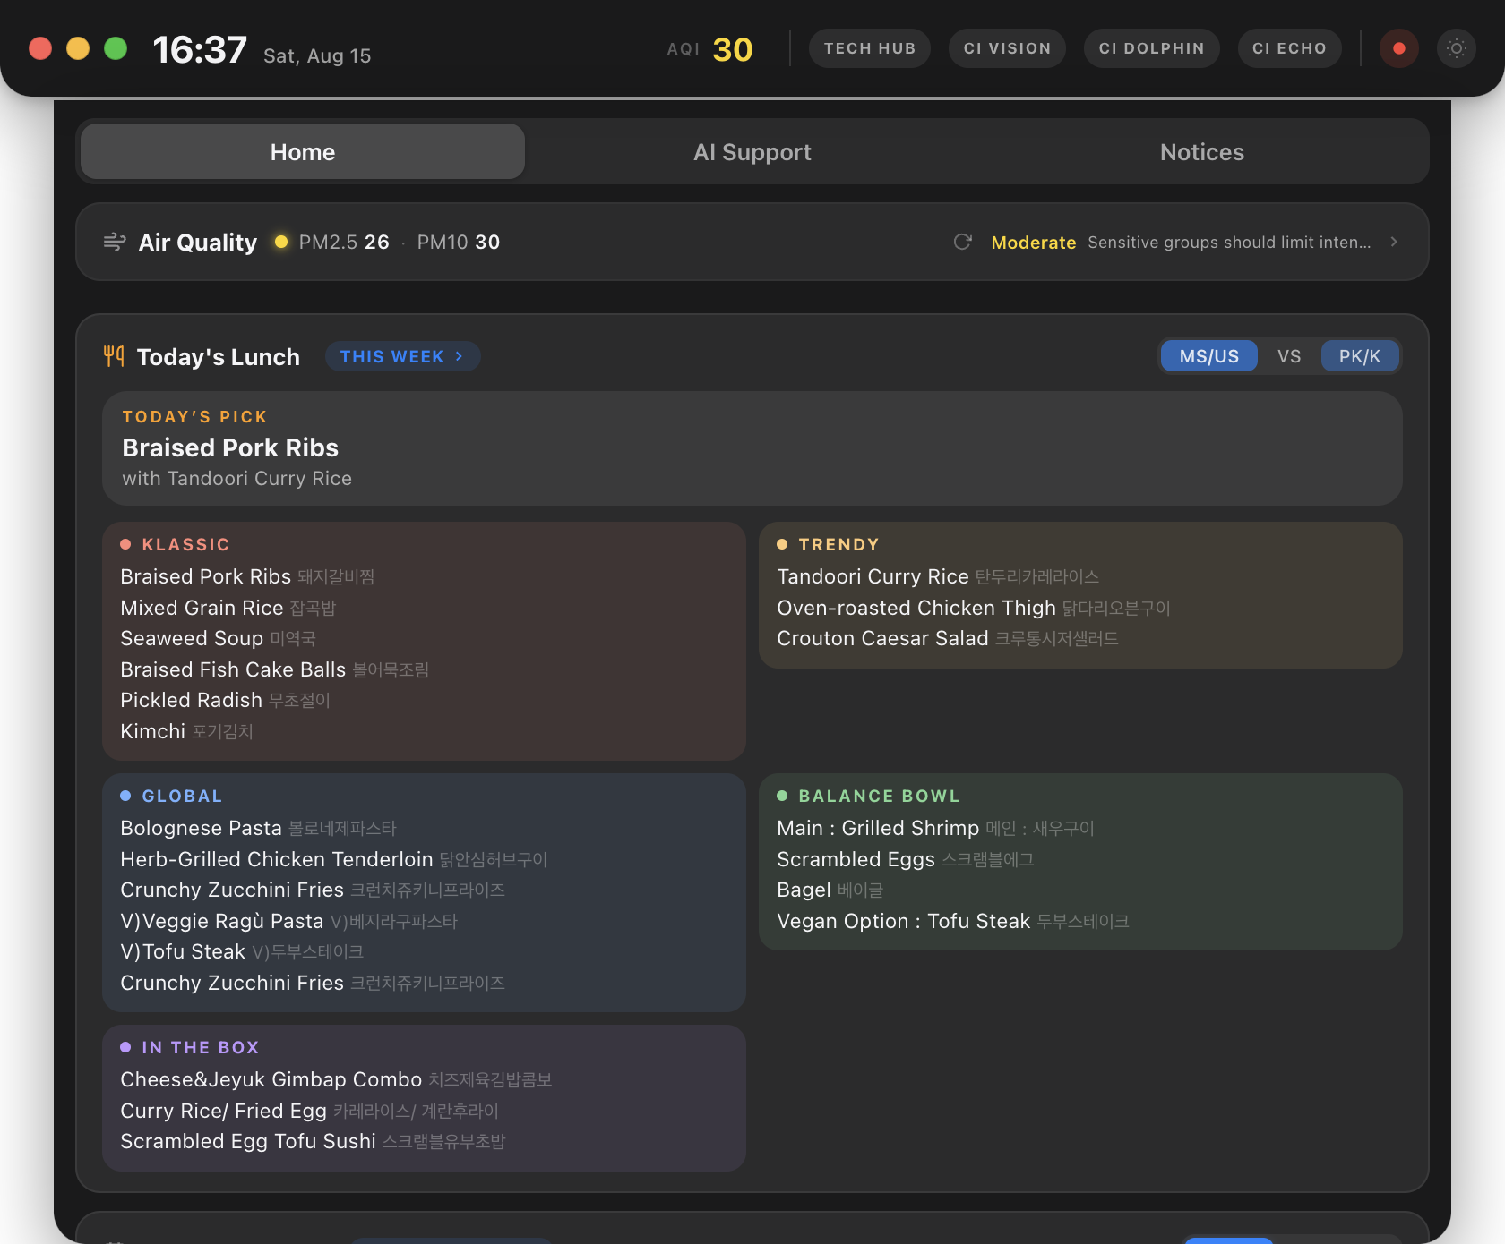
CI Hub
Teacher Guide
The menu-bar widget on every school MacBook: air quality, heat alerts, lunch, calendar, AI support and a direct line to the Tech Office — one click from the top of your screen.
Chadwick International · Technology Office · 2026-27

Slide 2
Where is it? How do I open it?
CI Hub lives in your menu bar. It starts by itself when you log in.
1
Open
2
Close
Click the CI Hub icon at the top-right of your screen (in the menu bar, next to Wi-Fi and the clock). The widget drops down from the top of the screen.
Click anywhere outside the widget, or the red dot at its top-left. It hides — it does not quit.
3
Resize & move
4
Quit?
Drag any corner to resize. Green dot = fill the screen, yellow dot = back to the default size.
You never need to. If you do quit it, it comes back on its own within about 30 seconds so the alerts and lunch always work.

Slide 3
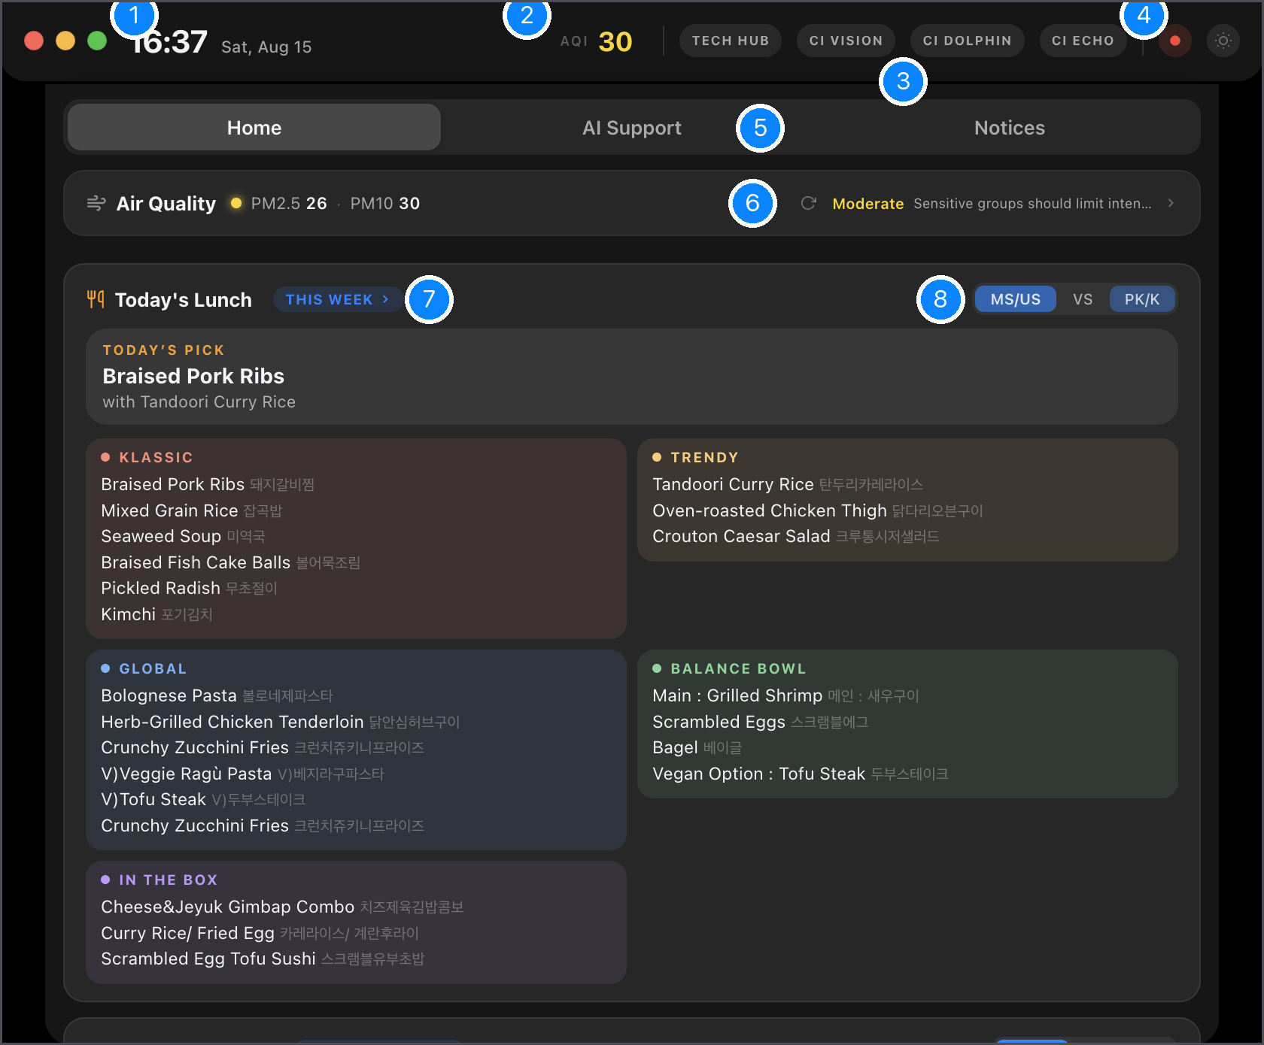
Home — everything at a glance
1
Window controls
Red hides the widget · Yellow restores the default size · Green fills the screen.
2
Air quality now
AQI for Songdo. Colour = level. Tap the Air Quality row below for details.
3
Quick links
TECH HUB website · CI VISION · CI DOLPHIN app · CI ECHO live translation.
4
Light / dark
Toggle the widget theme.
5
Tabs
Home · AI Support · Notices.
6
Air Quality row
PM2.5 / PM10 and today's activity guidance. Click › to open the full panel.
7
This Week
Opens the whole week's lunch, day by day.
8
MS/US · VS · PK/K
Pick your division — the lunch card remembers your choice.
Below the lunch card: School Calendar (today / tomorrow, from Veracross) and Request to Tech Office.

Slide 4
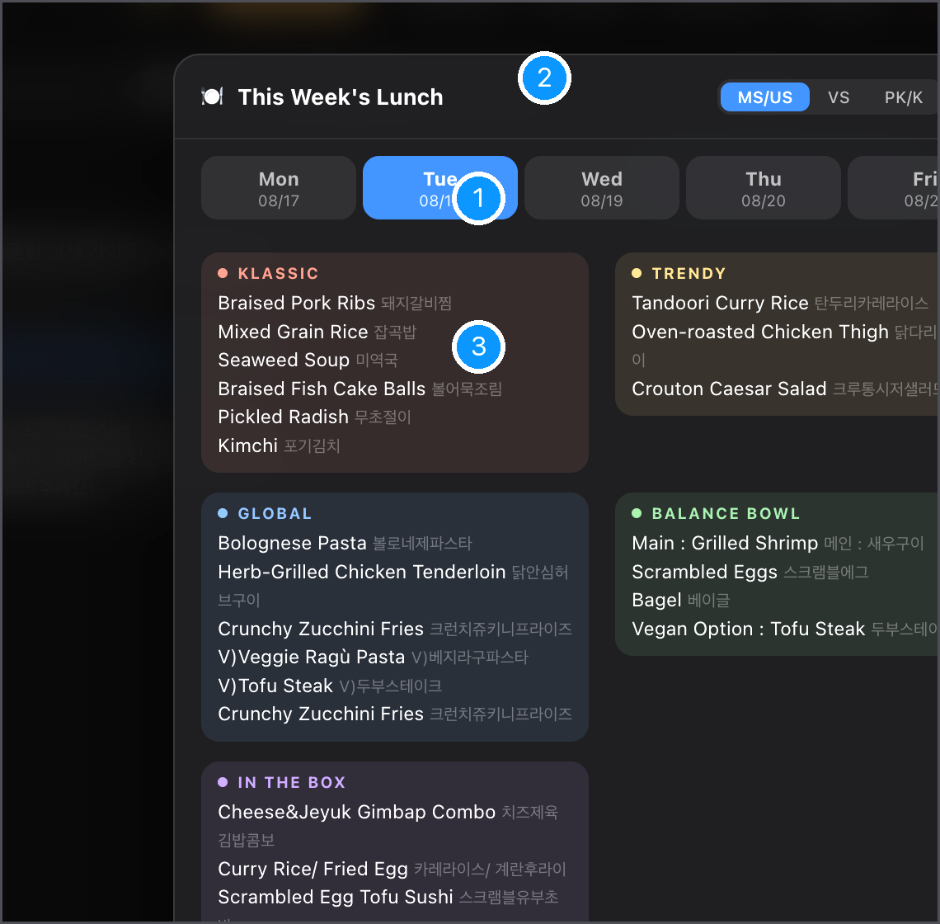
Today's Lunch
Menus come straight from the kitchen every week — no one has to type them in.
1
Day tabs
Mon–Fri of the current week. A day with no school simply says so.
2
Division
MS/US, VS or PK/K — each shows exactly what that cafeteria serves.
3
Stations
MS/US: Klassic · Trendy · Global · Balance Bowl · In the Box, each in its own colour. Korean names sit next to the English.
On the Home tab, "Today's pick" shows the day's main dish with a small illustration.

Slide 5
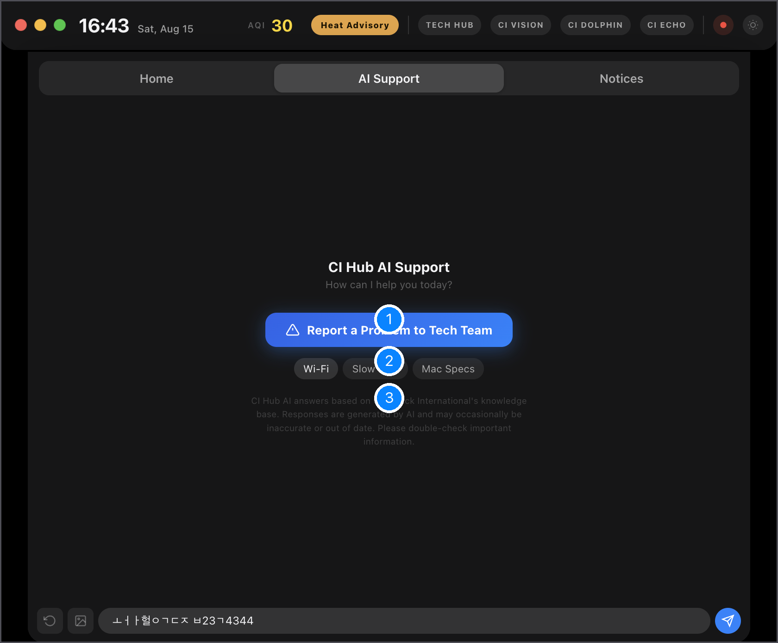
AI Support — ask first, it's fast
A school-specific assistant that knows our systems, printers, Wi-Fi, Veracross, Jamf and more.
1
Report a Problem to Tech Team
One click opens a ticket to the Tech Office when you already know you need a person.
2
Quick questions
Wi-Fi · Slow Mac · Mac Specs — tap to ask instantly.
3
Good to know
The AI answers from Chadwick's knowledge base and can be wrong. Double-check anything important.

Slide 6
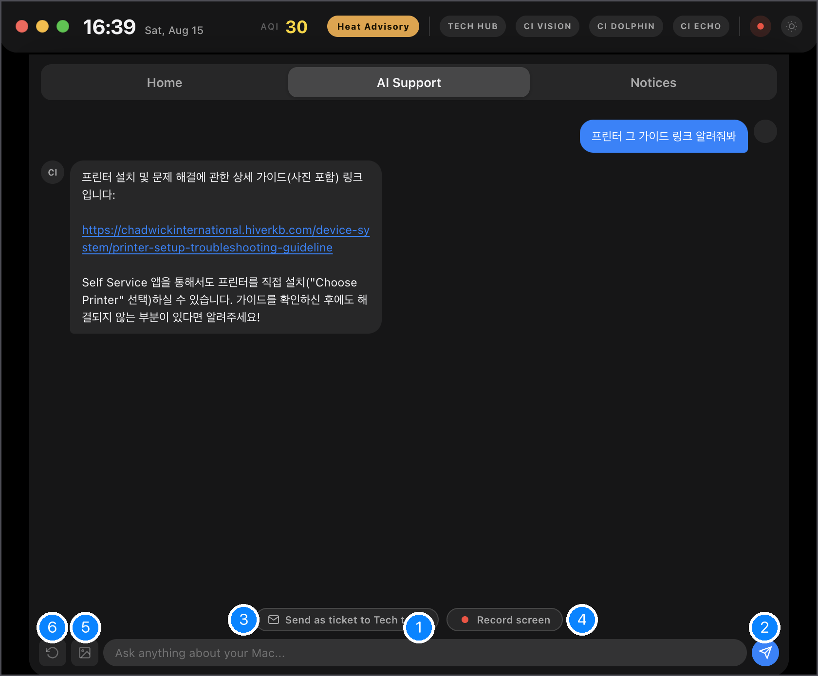
AI Support — the conversation
Type in Korean or English. It links you to the right guide, or walks you through the fix.
1
Ask anything about your Mac
Printer setup, projector, passwords, software… plain language is fine.
2
Send
Or press Return.
3
Send as ticket to Tech team
Not solved? The whole conversation goes to us as a ticket — you don't retype anything.
4
Record screen
Capture a short clip of the problem to attach.
5
Upload a photo
Snap the error / the cable / the screen — the AI looks at it and finds the problem.
6
New chat
Start fresh.

Slide 7
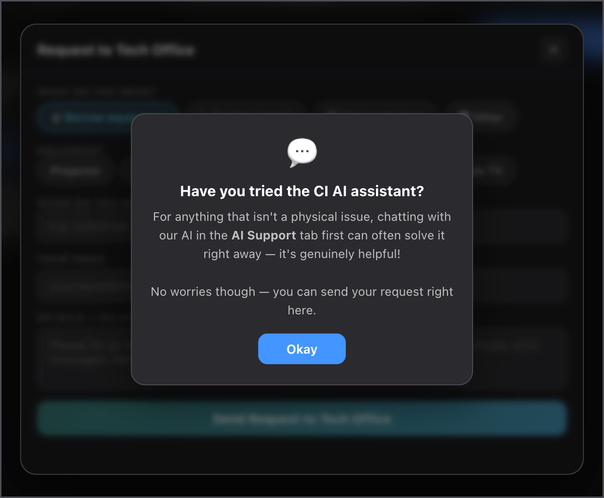
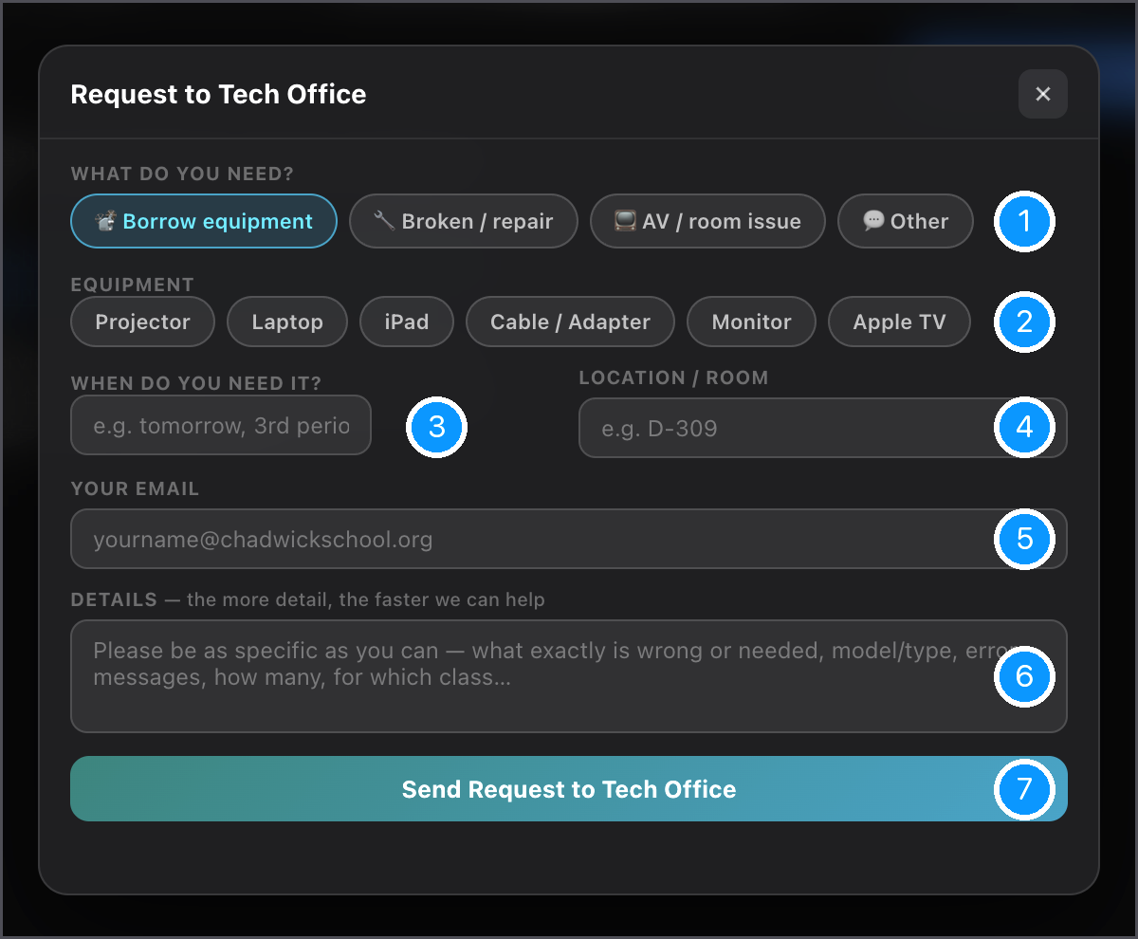
Request to Tech Office
Borrow equipment · report something broken · AV / room issues · anything else.
1
What do you need?
Borrow · Broken/repair · AV/room · Other
2
Equipment
Projector, laptop, iPad, cable, monitor, Apple TV
3
When
e.g. tomorrow, 3rd period
4
Room
e.g. D-309
5
Your email
So we can reply to you
First, a gentle nudge: for anything that isn't physical, the AI usually solves it faster. Tap Okay to continue to the form.
6
Details
The more specific, the faster we can help
Track your requests any time under Home → your open request card. You can reply to us or withdraw a request from there.
7
Send
You get a notification when we reply or when it's done

Slide 8
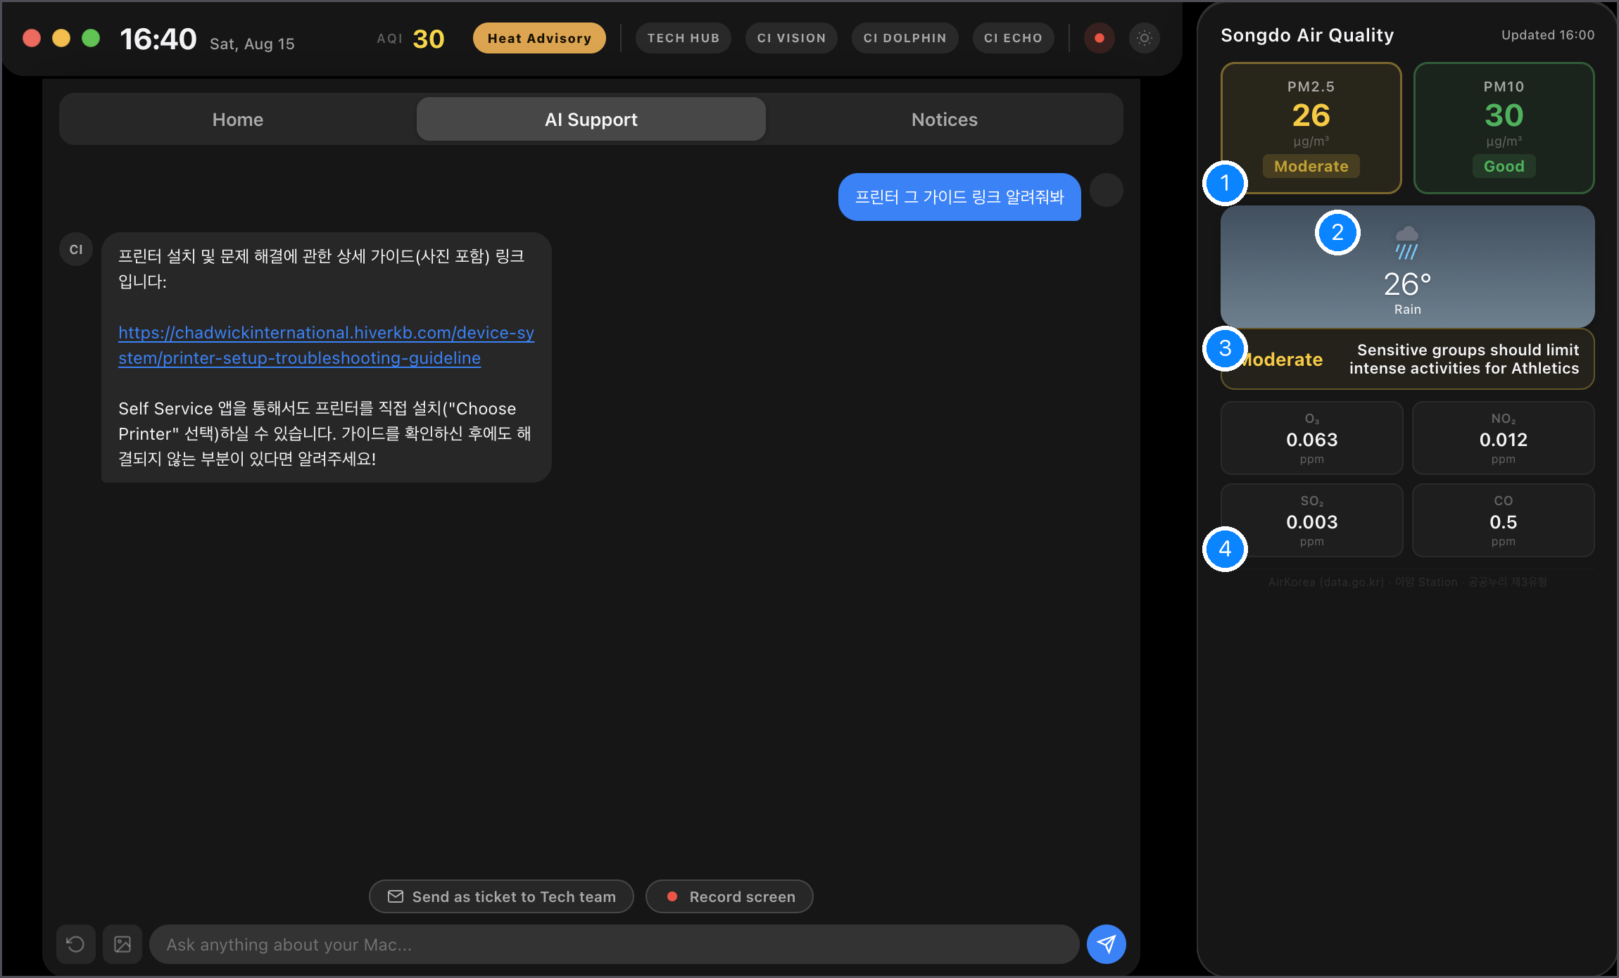
Air Quality panel
Click the Air Quality row (or the AQI badge at the top). A side panel opens next to the widget.
1
PM2.5 · PM10
Live from the AirKorea station nearest to campus (송도 · 아암). Colour = level.
2
Weather
Current conditions and temperature.
3
Activity guidance
What today's air means for outdoor time and Athletics.
4
Gases
O₃ · NO₂ · SO₂ · CO for the curious.
Click the row again to close the panel.

Slide 9
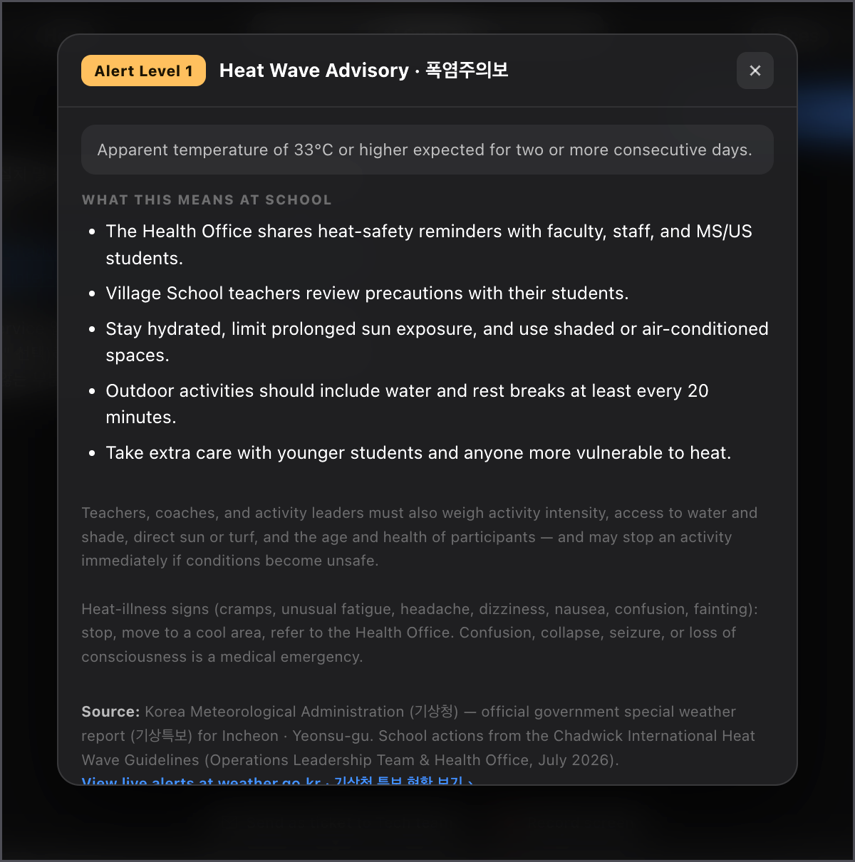
Heat-wave alerts
When KMA issues a heat alert for Songdo, an orange/red pill appears at the top and a Heat bar on Home.
1
What you'll see
Advisory (yellow) · Warning (orange) · Severe (red). Click the pill or the Heat bar to open this card.
2
What to do
Chadwick's own heat guidelines for that level — recess, PE, hydration, who to contact.
3
Notifications
You get at most two a day (morning and early afternoon). Don't want them? The bell switch on the Heat bar mutes them on your Mac; the bar itself stays.

Slide 10
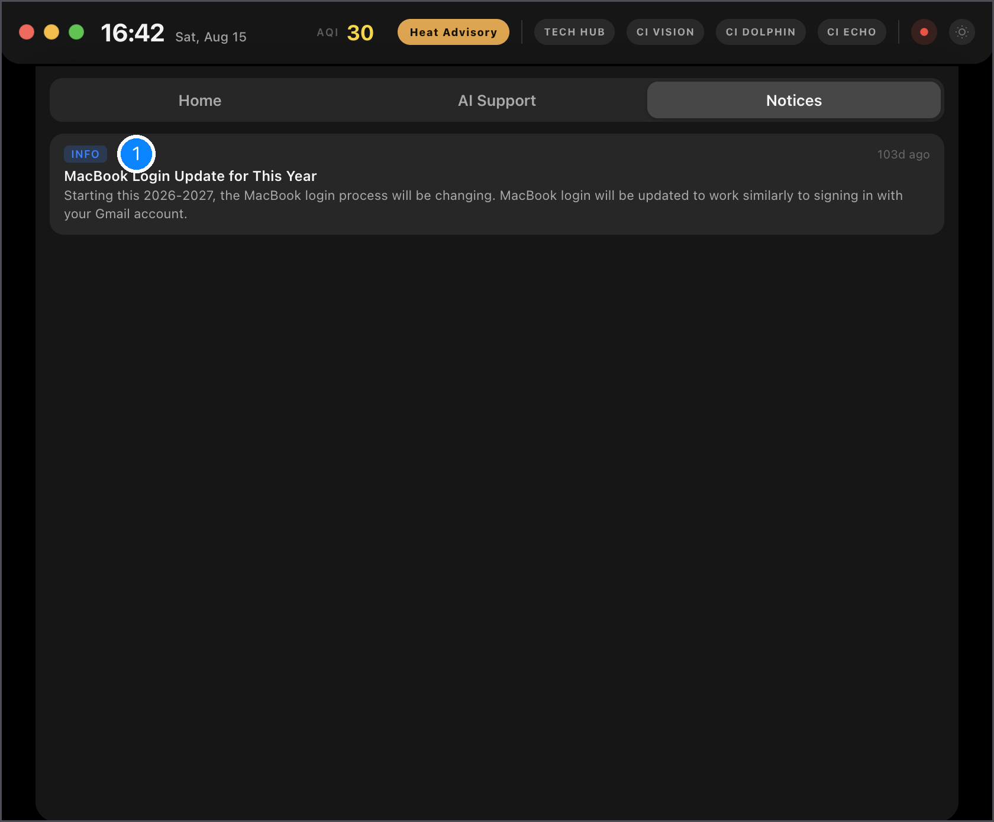
Notices & notifications
1
Notices tab
Announcements from the Tech Office — login changes, outages, new tools. Newest first.
You'll also get a normal macOS notification when: the Tech Office replies to your request · your request is confirmed or resolved · a heat alert is in force (max 2/day) · we send an urgent broadcast.

Slide 11
Quick answers
The widget disappeared from my menu bar
It shows "--" for air quality
Wait 30 seconds — it restarts itself. Still gone? Open Launchpad → CI Hub, or ask us.
The AirKorea feed is briefly down; it retries every 10 minutes on its own.
Can I turn off the heat notifications?
Does it update itself?
Yes — the bell switch on the Heat bar. It only affects your Mac.
Yes, silently. You never need to install anything.
Is my chat private?
Something is wrong with the widget itself
The AI conversation stays on your Mac unless you choose "Send as ticket". Tickets go only to the Tech Office.
AI Support → "Report a Problem", or email songdo-technology@chadwickschool.org.
Technology Office · songdo-technology@chadwickschool.org · Tech Hub: ci-tech-hub.pages.dev

